Slide 1
Cardiovascular Disease
Prediction
Binary Classification · XGBoost & Keras · 70,000 Patient Records
Team: Raneem Mansour · Qutada Shobaki · Sara Allan · Yousef Ghawi · Raghad Qafesha
Kaggle Dataset · Python 3.10 · Status: Completed

Slide 2
Problem & Goal
#1
What are we solving?
Cardiovascular disease kills millions annually, yet many cases go undetected until it's too late. We build a binary classification model that predicts CVD presence from patient medical and lifestyle data.
Cause of
Death Globally
Why it matters
① Prioritize high-risk patients for early intervention
② Reduce unnecessary tests for low-risk patients
③ Support preventive care and lifestyle decisions
Cardiovascular Disease Prediction

Slide 3
Data Source & What It Contains
70,000
11 + 1
50/50
None
Patient Records
Features
Class Balance
Missing Values
medical exams
features + target
CVD / no CVD
clean dataset
Key Features
Dataset Notes
age
Patient age (converted from days to years)
▸ ~8.8% of patients smoke
▸ ~5.4% drink alcohol
▸ ~80% are physically active
▸ Age stored in days → converted to years
▸ Outliers removed: blood pressure, height, weight
ap_hi / ap_lo
Systolic / Diastolic blood pressure
cholesterol
1=Normal 2=Above normal 3=Well above
gluc
Glucose levels (same 3-level scale)
BMI
Engineered: weight / height²
cardio ★
Target: 1=CVD present 0=CVD absent
Cardiovascular Disease Prediction

Slide 4
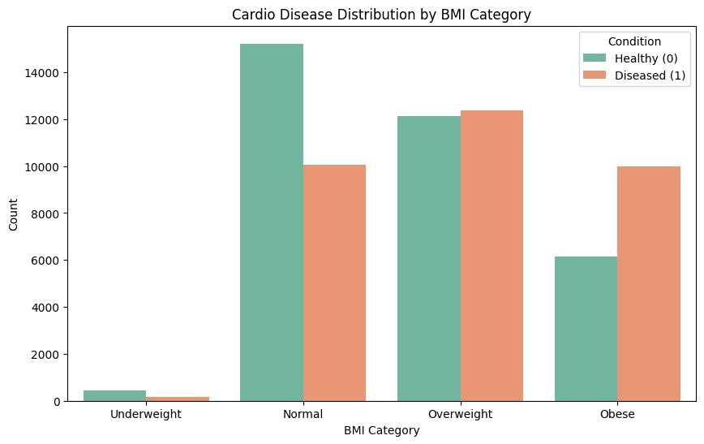
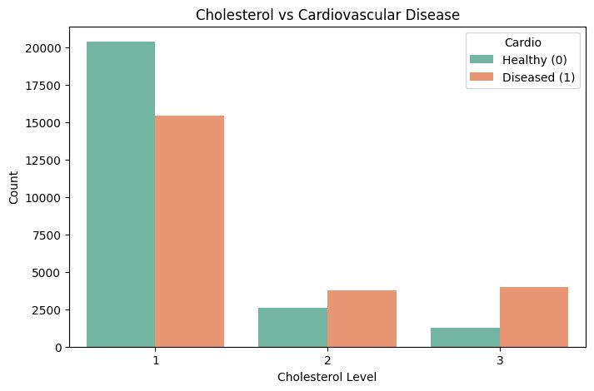
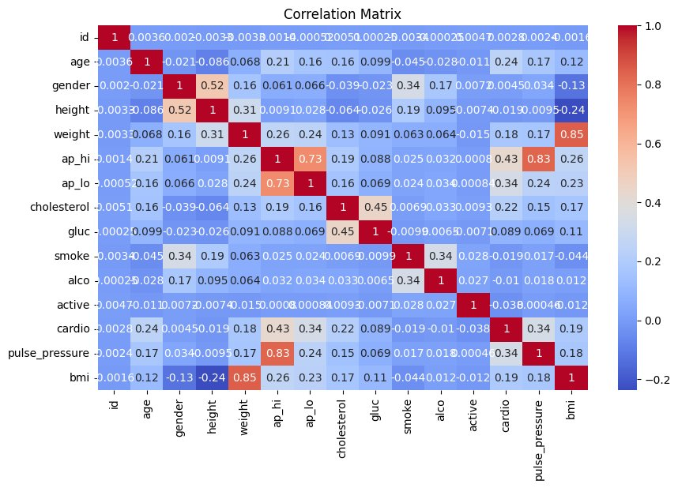
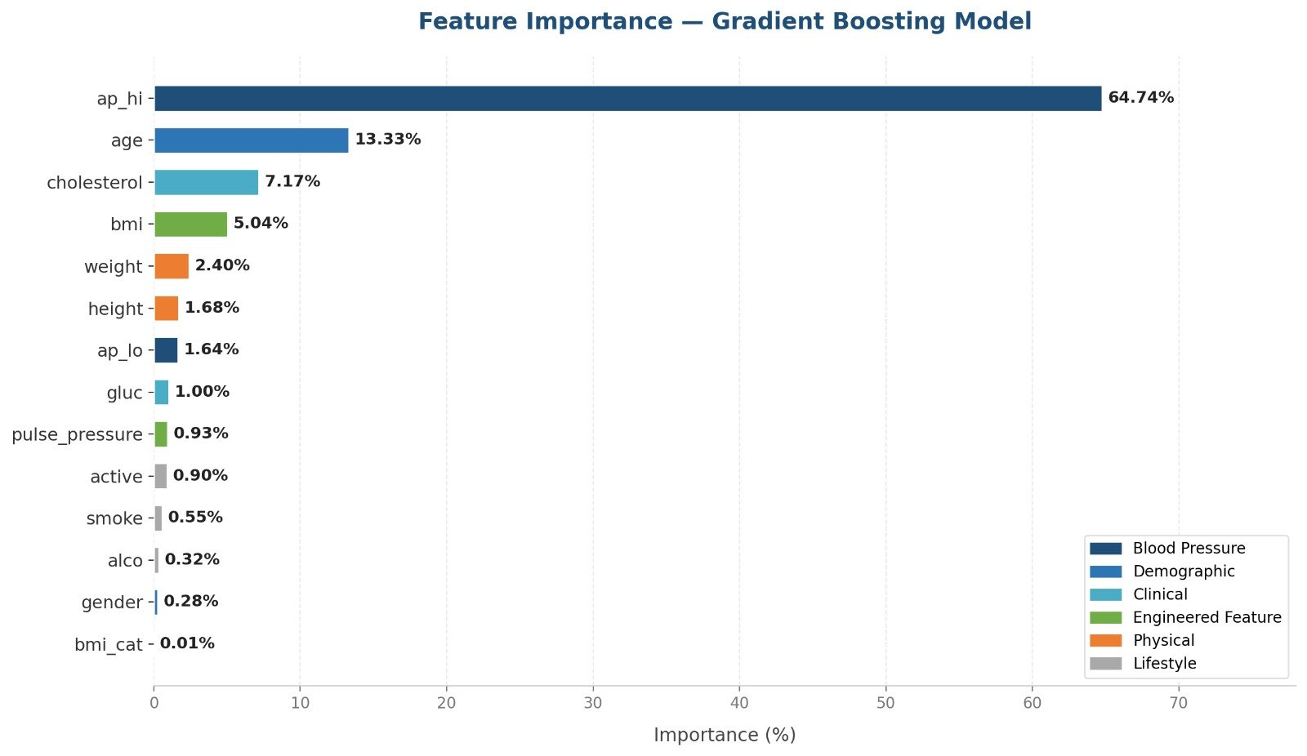
Key EDA Insights
Obese patients have significantly higher CVD rates vs normal weight
Higher cholesterol levels correlate strongly with CVD presence
ap_hi, age and cholesterol show strongest correlations with target
ap_hi alone accounts for 64.74% of XGBoost predictive signal
Cardiovascular Disease Prediction

Slide 5
Approach & Models
Data Cleaning
→
Feature Engineering
→
EDA
→
Modeling
→
Evaluation
Model 1: Gradient Boosting (XGBoost)
Model 2: Neural Network (Keras)
Builds an ensemble of decision trees sequentially — each new tree corrects the residuals of the previous ones.
Multi-Layer Perceptron (MLP) with 3 hidden layers. Uses ReLU activation, Adam optimizer, and early stopping to prevent overfitting.
Key hyperparameters:
Architecture:
• n_estimators = 300
• learning_rate = 0.05
• max_depth = 5
• subsample = 0.8
Input
128
64
32
Output
→
→
→
→
ReLU · Adam · Early Stopping
✓ No feature scaling required
⚠ Requires StandardScaler on training data
Cardiovascular Disease Prediction

Slide 6
Results & Evaluation
Model Accuracy Comparison
XGBoost (recommended)
73.92%
Neural Network (Keras)
73.80%
Baseline (majority class)
50.00%
XGBoost Feature Importance
ap_hi (systolic BP)
62%
age
13.8%
cholesterol
6.97%
BMI (engineered)
5%
MAP (engineered)
4%
Lifestyle features
1.5%
Cardiovascular Disease Prediction

Slide 7
Conclusions & Next Steps
What We Learned
Suggested Next Steps
▸ ap_hi is the dominant predictor (62% importance)
▸ Engineered features (BMI, MAP) beat raw lifestyle data
▸ Both models converge at ~73–74% — a data ceiling, not a model limit
▸ XGBoost outperforms Keras: faster, no scaling, more interpretable
▸ Data cleaning removed 1,369 impossible rows — quality matters
1. Deploy XGBoost — as production model — higher accuracy, no scaling
2. Add richer features — ECG, imaging, blood panels, family history
3. Ensemble both models — XGBoost + Keras for ~0.5–1% gain
4. Validate geographically — test generalizability across populations
5. Fix self-reported data — better collection for lifestyle variables
Cardiovascular Disease Prediction

Slide 8
Limitations & Ethics
Model Limitations
Ethical Considerations
• 73–74% accuracy ceiling — imposed by data, not models
• Weak feature correlations (strongest: age at 0.24)
• No ECG, imaging, or family history in dataset
• Gender imbalance: ~60% female records
• Unknown data collection date — temporal limitation
• NOT a diagnostic tool — decision support only
• Must not replace clinical judgment or expertise
• Self-reported lifestyle data has measurement error
• No geographic label — generalizability unknown
• Real deployment requires HIPAA / GDPR compliance
⚠ Important: This model is a clinical decision-support tool only. It must always be reviewed by qualified medical professionals and cannot replace diagnosis, treatment, or clinical expertise.
Cardiovascular Disease Prediction

Slide 9
Thank You
Questions & Discussion
Raneem Mansour · Qutada Shobaki · Sara Allan · Yousef Ghawi · Raghad Qafesha

